Slide 1
CS341 Lab 9:
Measuring a function
https://github.com/whittyh/CS341

Slide 2
Lab 9 Objectives:
Use function generator and oscilloscope to learn about function waves
Measure frequency

Slide 3
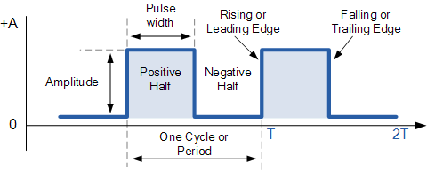
Waves:
Pulse Width: how long the signal remains HIGH
Period: The time it takes for the wave to repeat
Frequency: 1/Period
We can think of frequency as a measure of how dense the wave is

Slide 4
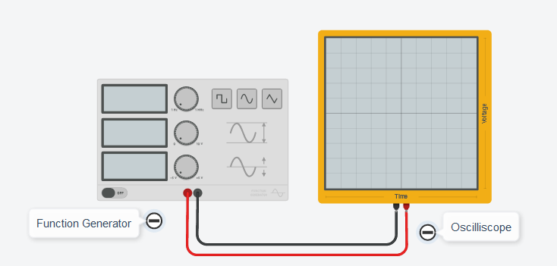
Function Generator:
Outputs a wave-like electrical signal
Settings:
Frequency: how many times the wave will be repeated in 1 second
Amplitude: The difference in voltage between the top of the wave and the bottom of the wave
DC Offset: the voltage amount that the wave is centered at
Function: change between rectangular, smooth, or triangular wave

Slide 5
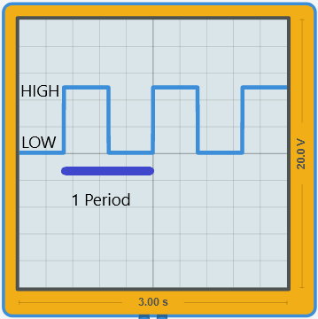
Oscilloscope:
Visually observe the wave function:

Slide 6
Part 2:
Create an Arduino program that reads a digital signal and calculates:
Period:
Time from peak to peak of wave
Frequency:
1 / period
Pulse width (optional):
Time wave signal is ‘high’
Some tips:
Display numbers in seconds
Serial.println(frequency, 5);
Be careful of division between two integers

Slide 7
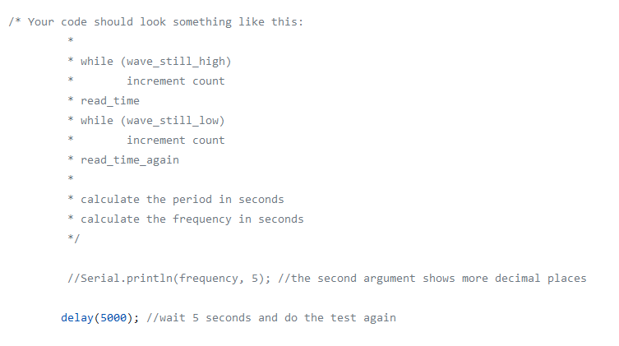
The Starter Code:

